Slide 1
MOOCS BASED SEMINAR
Deep Neural Networks with PyTorch
Presented By : Deepankar Sharma
Course: BCA-5th
University Roll No: 2092014

Slide 2

1 D - Tensors and 2 D - Tensors
Linear Regression: Gradient Descent and Loss
Logistic Regression: Gradient Descent and Loss
CONTENTS
Project Showcase

Slide 3

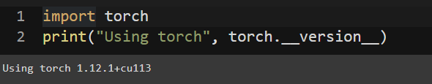
PyTorch
PyTorch is a machine learning framework based on the Torch library, used for applications such as computer vision and natural language processing,originally developed by Meta AI and now part of the Linux Foundation umbrella. It is free and open-source software released under the modified BSD license.
Tesla's development team uses PyTorch for its self-driving cars, including for features like Auto Pilot and Smart Summon.

Slide 4
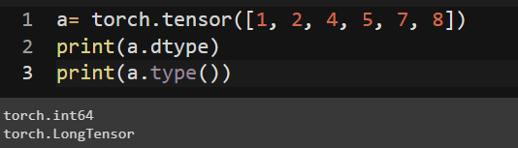
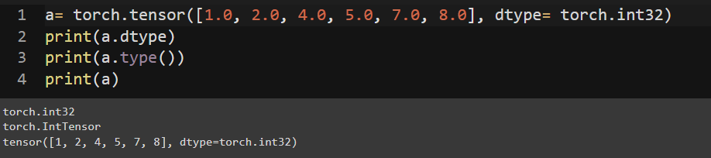
1 D - Tensors: #Rank 1 Tensors

Slide 5
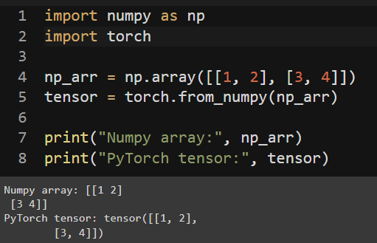
2 D - Tensors: #Rank 2 Tensors

Slide 6
Linear Regression

Slide 7
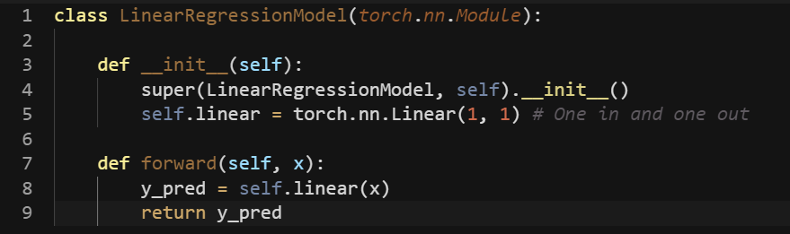
Linear Regression

Slide 8
Linear Regression: Gradient Descent and Loss

Slide 9
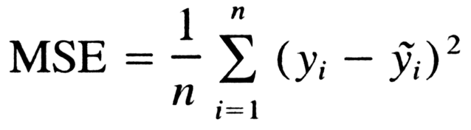
Linear Regression: Loss

Slide 10
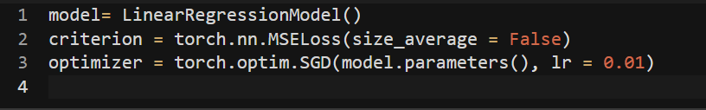
Linear Regression: Gradient Descent

Slide 11
Logistic Regression

Slide 12
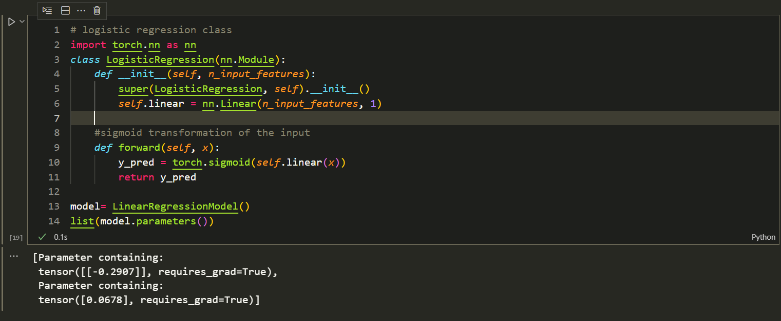
Logistic Regression

Slide 13
Logistic Regression: Gradient Descent and Loss

Slide 14
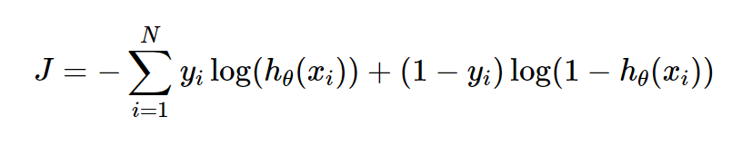
Logistic Regression: Loss

Slide 15
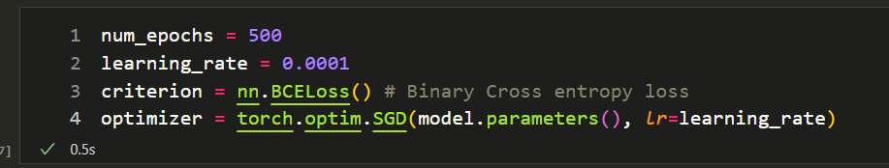
Logistic Regression: Gradient Descent

Slide 16
Project Showcase

Slide 17
Not Quite a Self-Driving Car - Traffic Sign Classification

Slide 18
Feedback
?

Slide 19
THANK YOU

